Slide 1
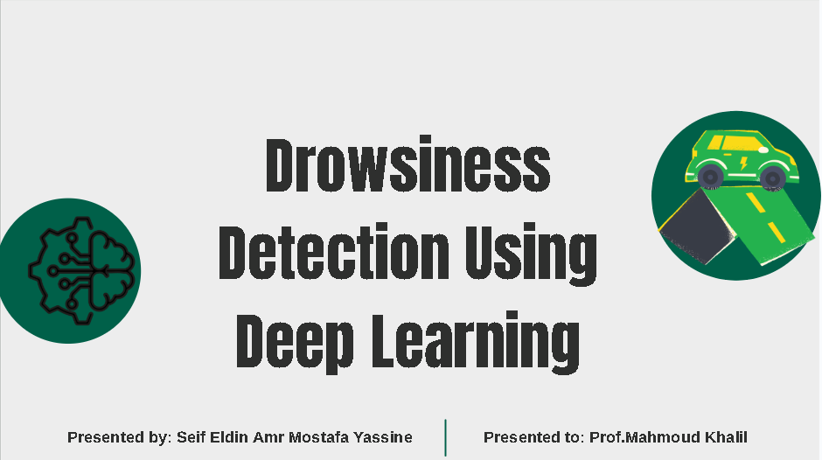

Slide 2
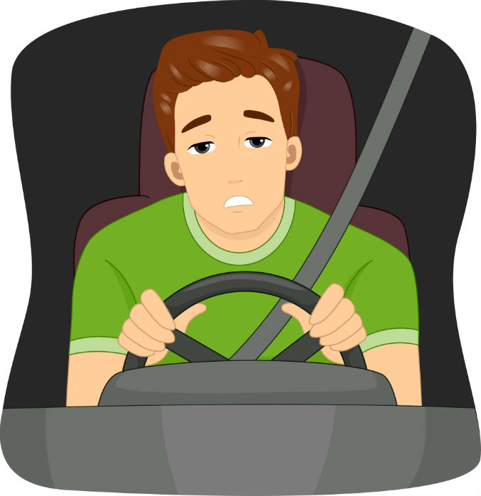
Content
Introduction
Mobile App Deployment
01
05
Objectives
Results & Analysis
02
06
Model Development
Future Work
03
07
Desktop-Based Systems
04

Slide 3
01 Introduction

Slide 4
Percentage of U.S. vehicle crashes involving a drowzy driver
Fatal Crashes
21%
Severe Injuries
13%
Overall Car Crashes
6%
0%
5%
10%
15%
20%
25%
Source :AAA Foundation for Traffic Safety
Drowsy drivers were involved in 91,000 police-reported crashes in 2017. These incidents resulted in injuries for an estimated 50,000 people and killed nearly 800.

Slide 5



Did you know?
Drowsy driving can be as dangerous as drunk driving
Comparable Blood
ALCOHOL
CONTENT (BAC)
Hours awake
24 Hours
0.1% BAC
20 Hours
0.08% BAC
(LEGAL LIMIT)
18 Hours
0.05% BAC
More than 1 in 5 fatal crashes involve drowsy driving.
Source: Williamson, A. M., & Feyer, A. M. (2000). Occupational and environmental medicin

Slide 6
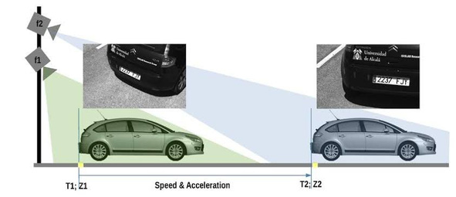
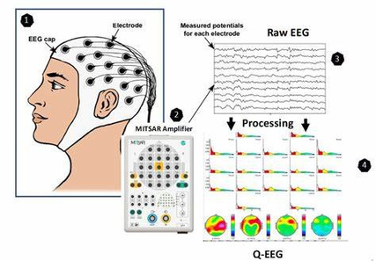
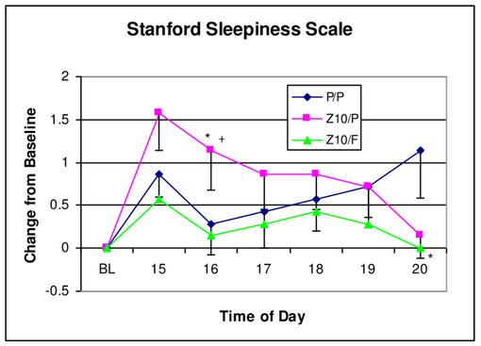
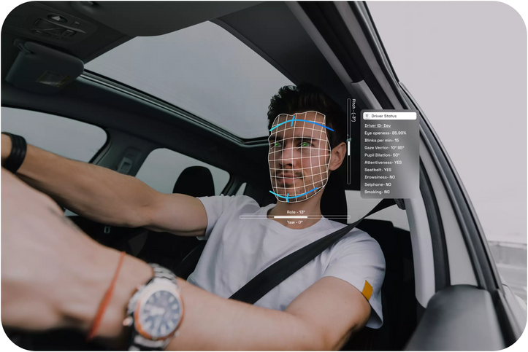
Literature Review
Vehicle Based Measures
Physiological Measures
Subjective Measures
Behavioural Measures

Slide 7
Improvements
Model Data Augmentation
Advanced Eye and Face Recognition
Transfer Learning and Model Optimization
Deployment in Mobile Apps

Slide 8

02 Objectives

Slide 9
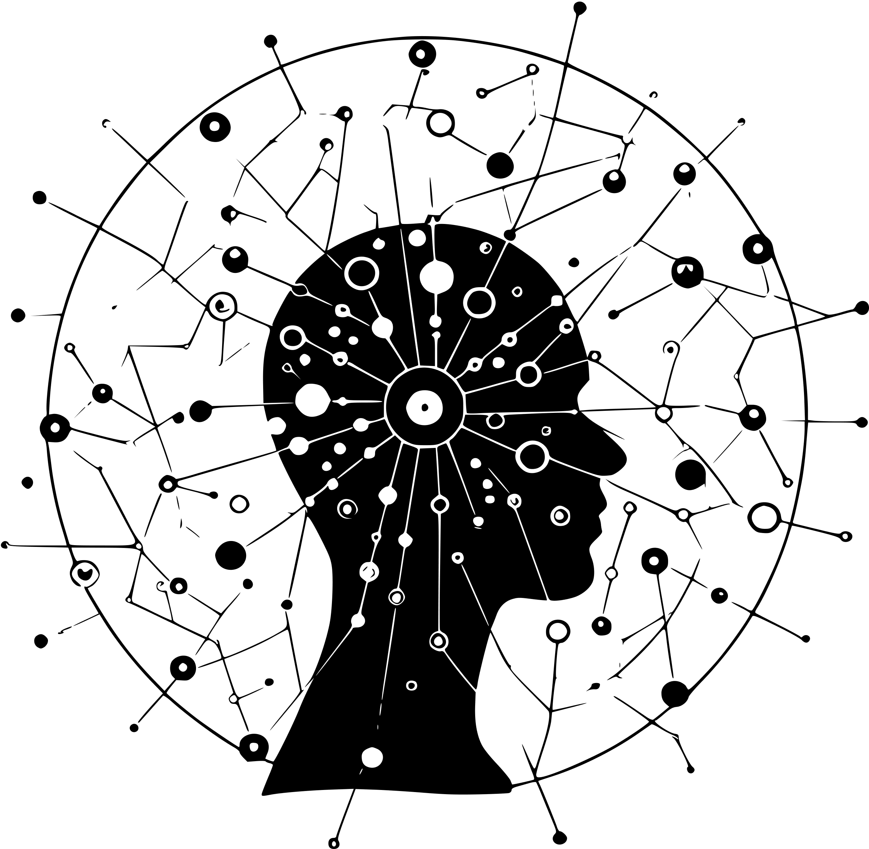

Slide 10
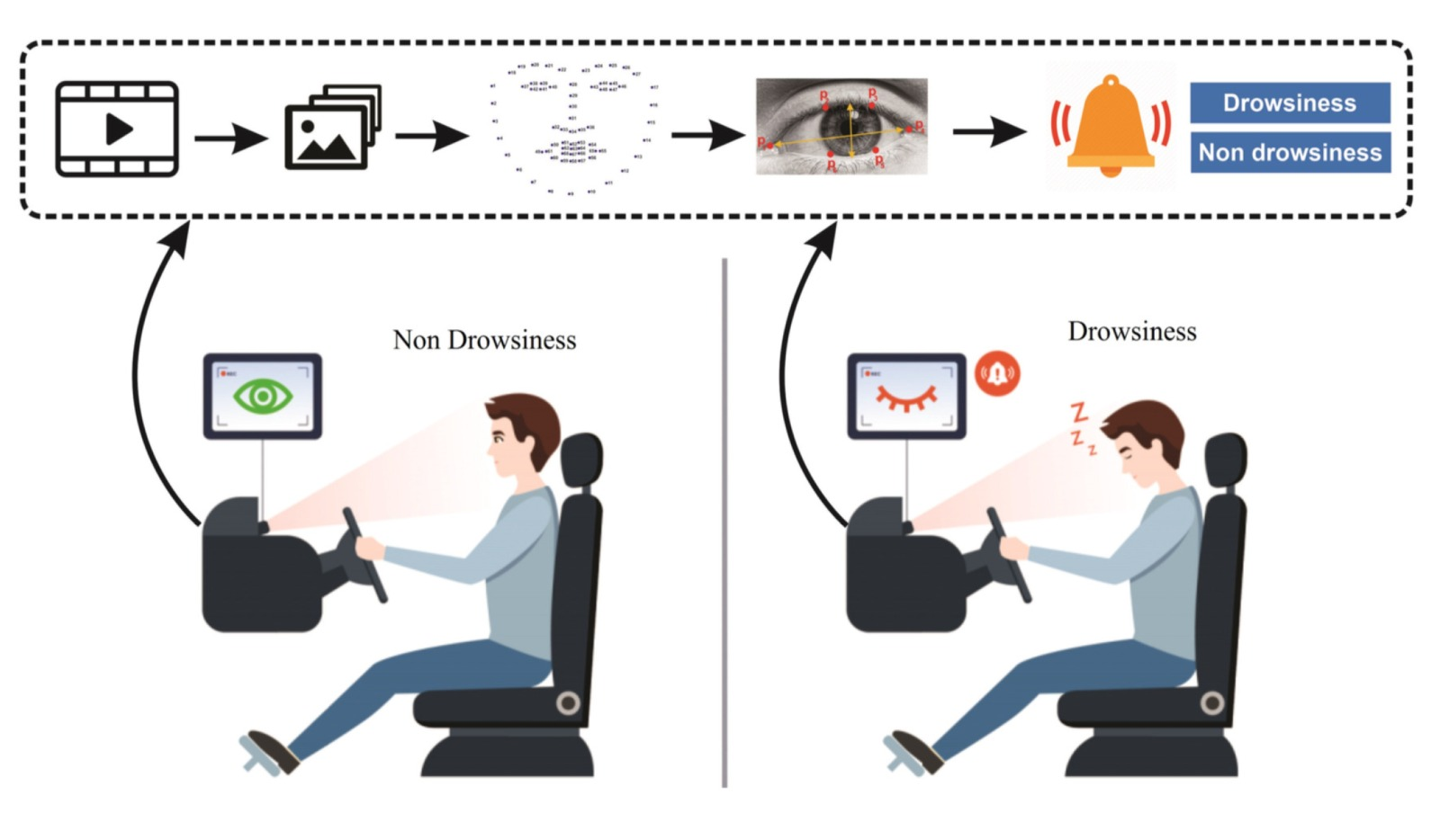

Slide 11


Slide 12
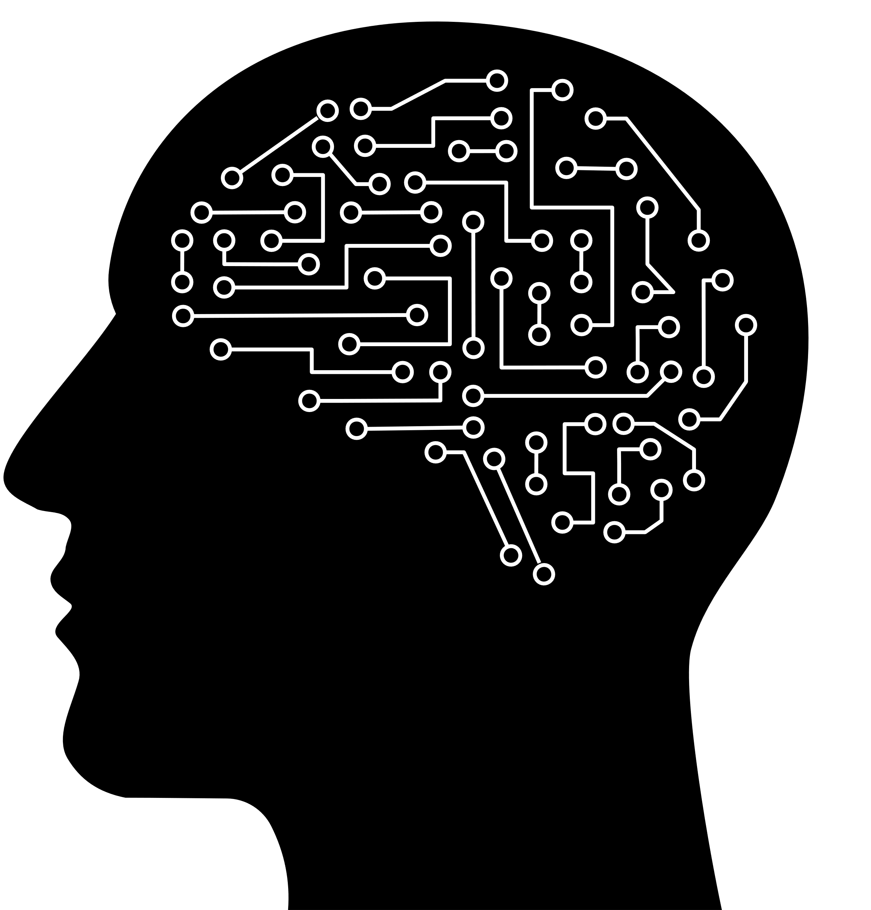
03 Model Development

Slide 13

Transfer Learning Model
Fine-Tuning and Finalization
Data preparation and augmentation
Model Training
Performance Evaluation

Slide 14
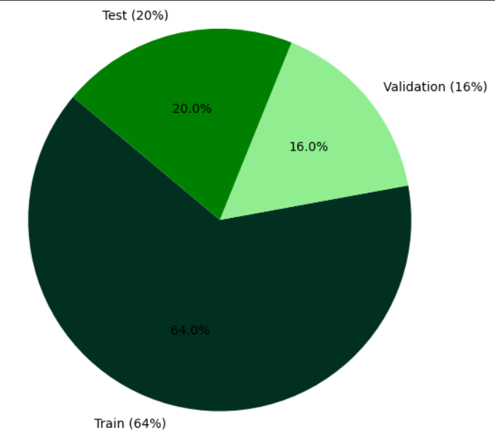
Data Preparation
Data Collection and Preprocessing:
Collected images of Open Eyes (1) and Closed Eyes (0)
Resized all images to 64×64 RGB
Split dataset into:
Training (64%)
Validation (16%)
Test (20%)
Ensured balanced class distribution (stratified split)

Slide 15
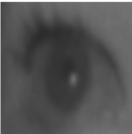
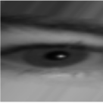
Data Augmentation
Enhancing Generalization with Augmentation:
Used ImageDataGenerator with:
height_shift_range=0.2
shear_range=10
rotation_range=20
zoom_range=0.5
brightness_range=[0.8, 1.2]
Augmented images = Original training size
Combined original + augmented data for training

Slide 16
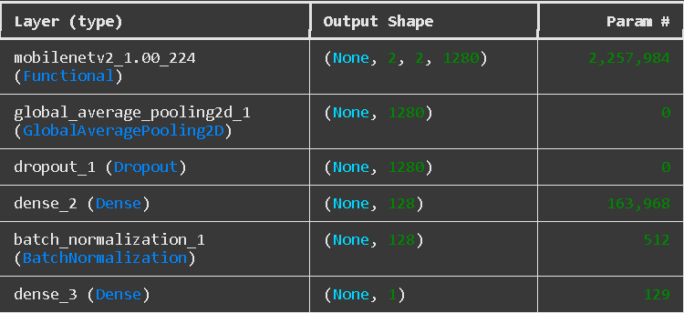
Transfer Learning
Model Architecture: Transfer Learning with MobileNetV2
Used MobileNetV2 pretrained on ImageNet
Set include_top=False to use as feature extractor
Initial training with base model frozen

Slide 17

Model Training
Model Training and Callbacks:
Compiled with Adam optimizer and binary_crossentropy
Used:
ModelCheckpoint (save best by val_loss)
EarlyStopping (stop if val_accuracy doesn't improve)
Trained for 50 epochs on training+augmented data

Slide 18

Fine-Tuning
Fine-Tuning the Pretrained Model:
Unfroze base model layers after index 100
Recompiled model with low learning rate (1e-5)
Trained for additional 30 epochs
Purpose: Adapt pretrained layers to the eye dataset

Slide 19

04 Desktop-Based Systems

Slide 20
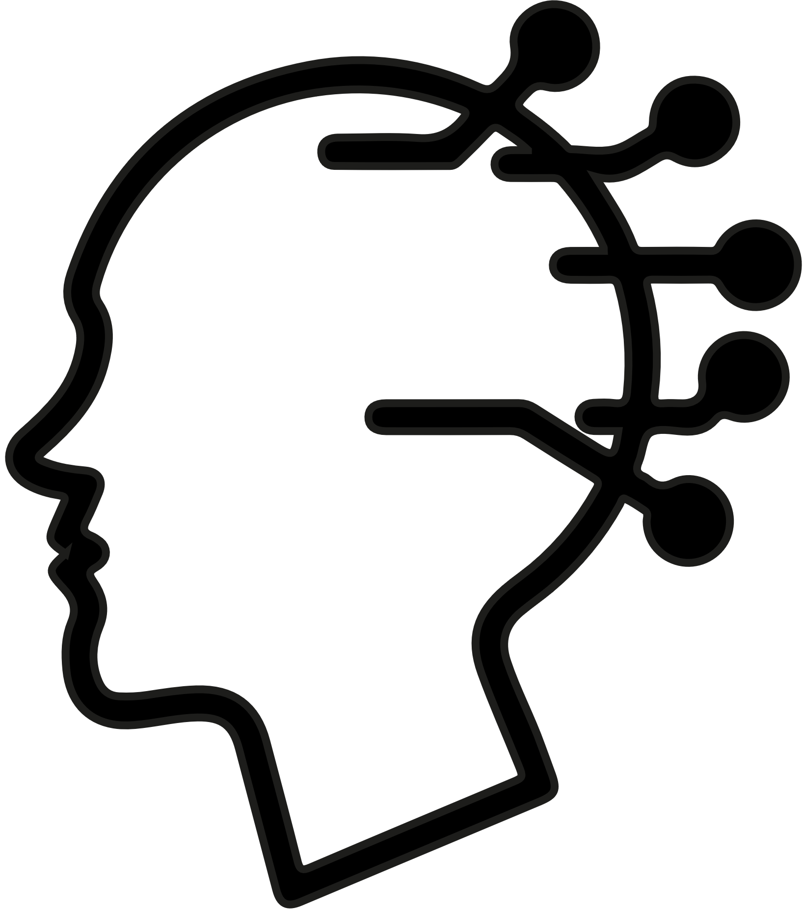


Systems Integration
Model Integration:
Pre-trained TensorFlow model predicts eye status (Open/Closed).
Real-Time Video Processing:
Use any face detection technique to detect eyes and send cropped eyes for model prediction
Captures video feed using OpenCV.
Alert Mechanism:
Tracks eye closure score in real time.
Triggers audio alarm if the score exceeds the threshold (indicative of drowsiness).
Notes:
tyb ehna mawdo3na 3n el drowsiness detection using deep learning
we da el content beta3na we hanebda’ bel introduction
ehna 3arfeen tab3an en hawades el arabyat haga bashe3a we
betsabeb khasayer fel arwah we khasayer maddeya kebera
we 3arfeen en leha asbab kteera wadha bas ana harakz enharda ala
sabab kawy w howa el driver drowsiness
tab eshm3na
ashan fe ehsa’eya et3amelt fe america ala 2000 driver bet’ool en 21
fel meya mn el fatal crashes we 13 fel meya mn el esabat el khateera
we 6 fel meya mn hawades el arabeyat besefa ama kolhom be
sabab el drowsiness
we fe ehsa’eya kaman betkaren khotoret ta’seer el khomor be ta’ser
el hours awake bet’ool en 24 sa3a sahy nafs khotoret nesba 3alya
mn el alcohol zay ma bayen odamna
fa da sabab kafy le ehtemam el 3alam le hal el moshkla de
fa fel literature review bnshof aham 4 measures le halaha
fa awel eslob el vehicle based measures
we da bytrack kol haga leha 3elaka bel vehicle nafsaha zay el lateral
lanes el mashya feha el arabya we law fe iregular behaviour fe el
tana’ol benhom
law fe irregular behaviour fel steering wheel movement
aw irregular behaviour fel vehicle acceleration maslan yaani fe
haraka msh mantekeya le sor3et el arabya bel nesba le had faye’
tany noo3 physiological measures
fe 3 anwa3
awel noo3 bytabe3 haraket el 3en wel blink rate be estekhdam
electrodes hawalen el 3en
tany noo3 byestakhdem electrodes te track el brain activity
talet no3 bysagel el electrical signals lel alb we by’ees ekhtelafat el
heart rate
we talet eslob el subjective measures
we da by’es hagteen el karolinska we stanford sleep scale we dol
self reported scales byhadedo el shakhs da ader eno yesoo’ wala la
akher noo3 we da el ehna mohtameen beeh enharda
el behavioural measures
da by3temed ala 3 hagat
eye related features zy el eye open wala closed aw el ein
meghamada showyaa msh ma’fola
w facial expressions we da en yezhar ma3alem ta3ab aw eghad
zayed zay en el deiver yetaweb maslan
w head movements
we da byshof wad3 demagh el sawa’ law betmeel maslan le odam
aw lel ganb
fa habeb nekhosh alatool ala el solution architecture beta3na
hanebda’ bel data flow we baaden neshof el model architecture wel
implemetation details
wel system integrations
el mawdo3 be ekhtesar en fe driver mashy be shakl tabe3y we
ehna bnestakhdem camera bet capture live video btakhod meno
sowar kol agza’ mn el sanya ashan nehaded menha el awel frame el
wesh wel 3enen we baaden be estekhdam el pretrained model bn
classify drowsy aw laa we ala asaso bnshaghal el alert system in
case eno drowsy
da el model architecture beta3na howa bekhtesar 2 cnn blocks
baadehom fully connected layers
el implementation details zay mahna shayfen bnebda’ bl
preprocessing kaza kaza
training ….
call backs…
evaluation….
negy ala el systems integration
el system bytkawen mn 3 hagat mainly
el tensorflow pretrained model
el real time video processing bnestakhdem Haar cascade classifiers
el aleet mechanism by track el eye closure score eli initialized be
zero we by trigger alarm lama el score ye3ady threshold ana
ba7adedo
fel prototype results ana habett asawar video alatool lel process
el project time line mainly bytkawen mn 9 tasks……
we habeb awary hadratko kaman Gantt Chart byshrah el timeline
tayeb delwaaty baad ma 3erefna tafaseel el solution habeb awary
hadratko eh el future trends fel fatra el gaya fel mawdo3 da
……..
akher haga el challenges el waghetny wel improvements el
mekhatatlaha
……

Slide 21
Different Methodologies
Vehicle Acceleration
HAAR Cascade Classifiers
MTCNN Face Detection
DLIB Face Detection

Slide 22
1- HAAR Cascade Classifier
Overview:
Uses OpenCV’s Haar cascade classifiers to detect the face and eyes in webcam frames. Cropped grayscale eye regions are passed to a CNN model trained to classify open vs. closed eyes.
Key Features:
Fast and lightweight detection
Simple ROI extraction using fixed regions
Low Robustness for head tilting and poor lighting
Least accurate of the three due to sensitivity to noise

Slide 23
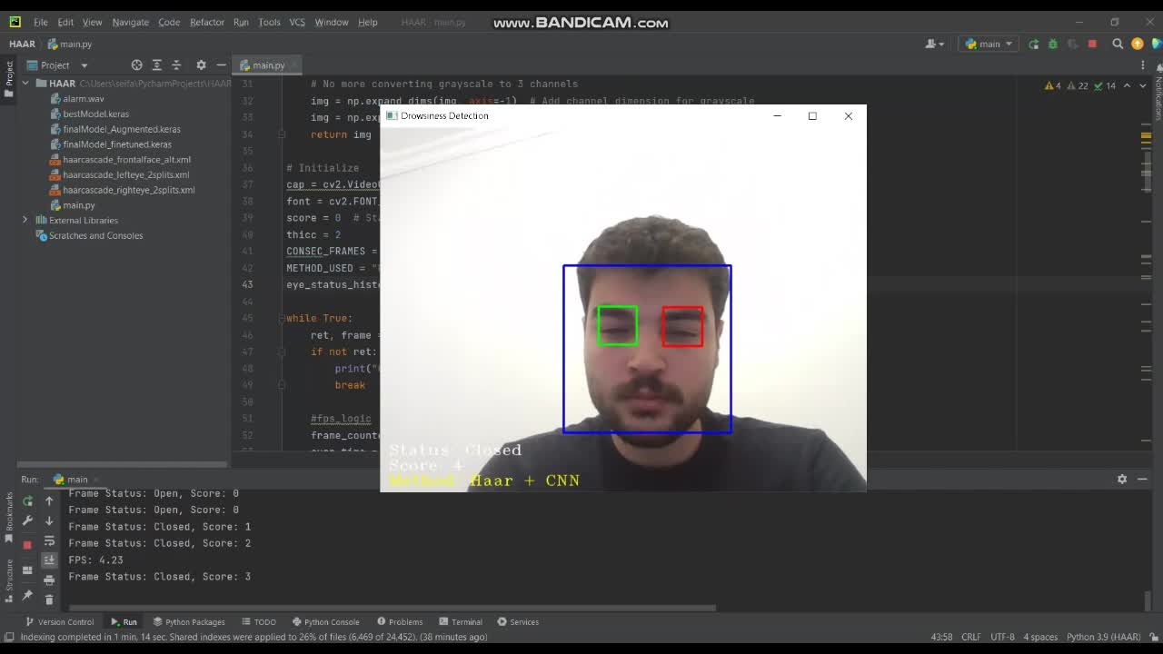

Slide 24
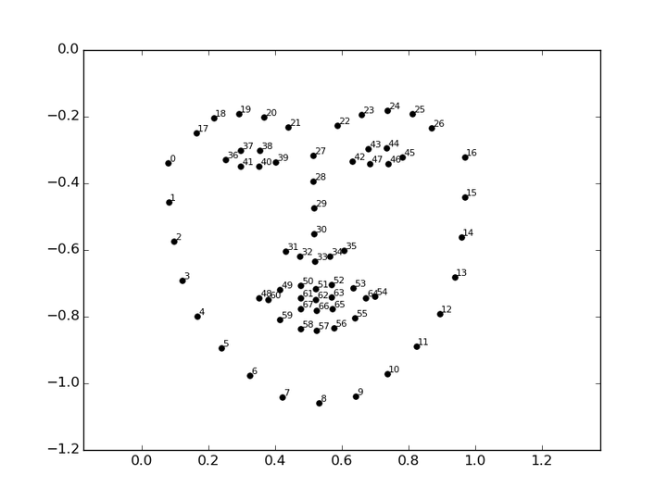
2- DLIB Facial Landmarks
Overview:
Uses Dlib’s frontal face detector and 68-point facial landmark predictor to precisely locate eye regions. These are then cropped and fed to the CNN classifier.
Key Features:
More accurate eye localization using facial geometry
Better robustness to head tilt
Moderate processing speed
Higher prediction accuracy than Haar method

Slide 25
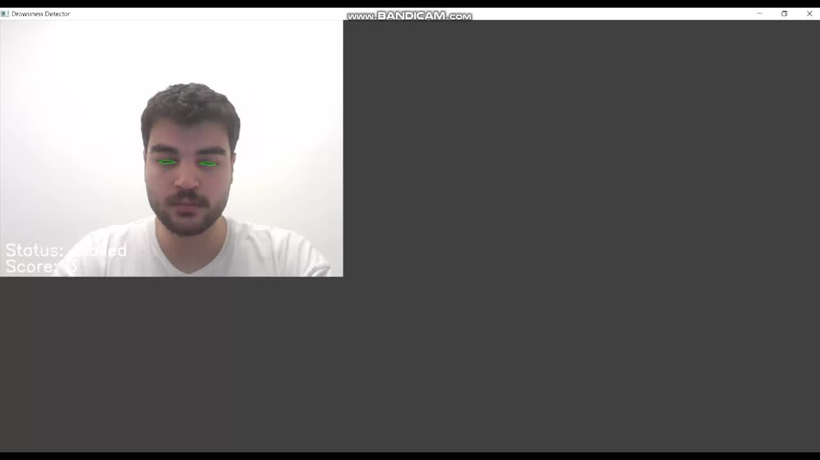

Slide 26
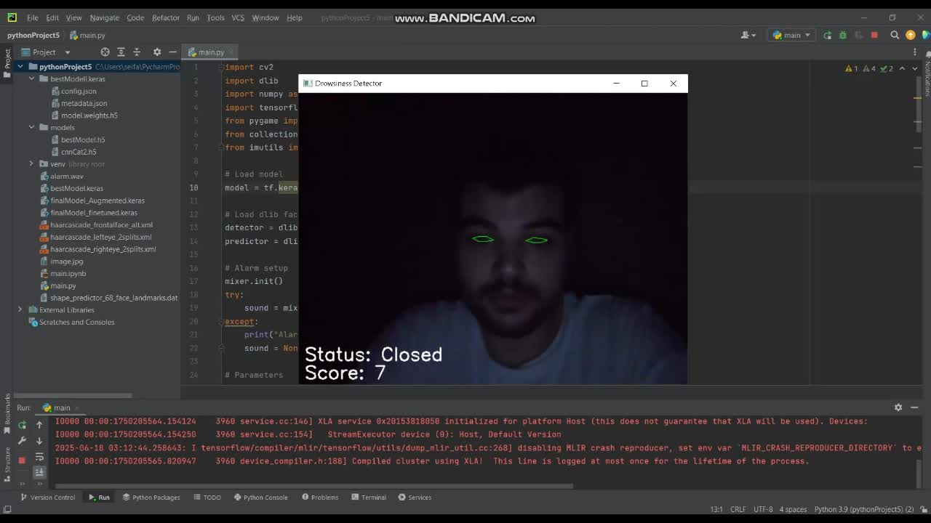

Slide 27
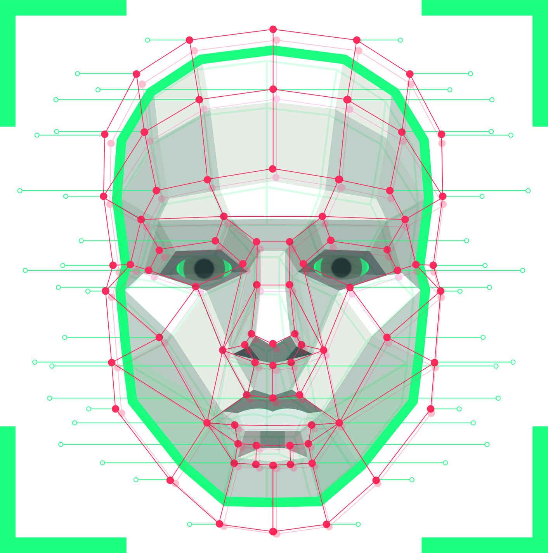
3- MTCNN (Deep Learning-based Detection)
Overview:
The MTCNN algorithm is a deep learning-based face detection and alignment method that uses a cascading series of convolutional neural networks (CNNs) to detect and localize faces in digital images or videos
Key Features:
Most accurate facial feature detection
Best robustness against varying angles and partial occlusions
Heavier in terms of computational load
Best balance between precision and reliability

Slide 28
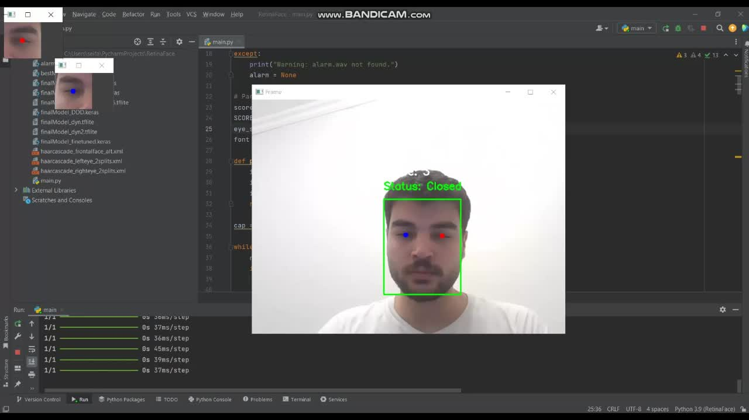

Slide 29
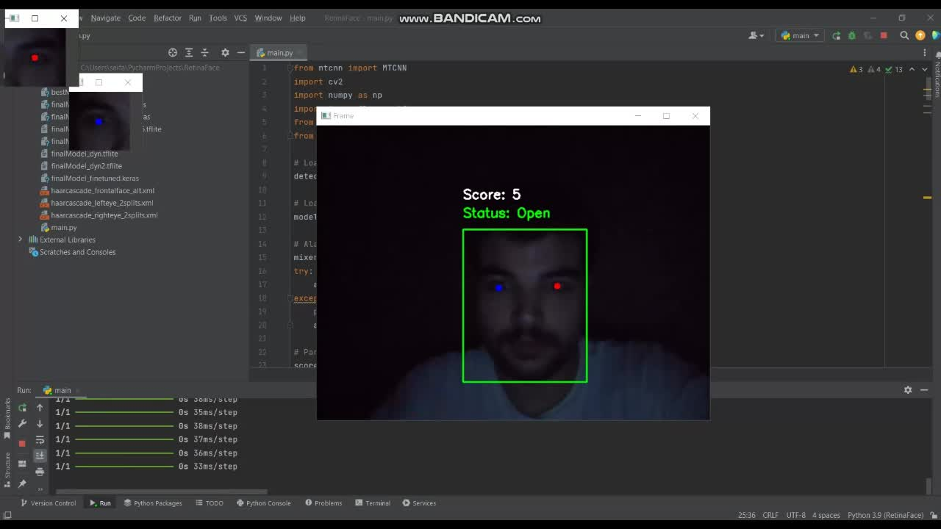

Slide 30
 | FPS | Alarm Responsiveness | Accuracy | CPU Usage
HAAR | 5.5 | 1.756 | Low | 27%
Dlib | 4.7 | 2.238 | High | 12%
MTCNN | 0.9 | 9.566 | Very High | 14%

Slide 31

05 Mobile App Deployment

Slide 32

Mobile App Deployment
Development Platform:
Built using Flutter for cross-platform compatibility.
Built for android devices with target sdk 35.
Utilizes camera, google_mlkit_face_detection, tflite_flutter, and just_audio packages.
Entirely runs on-device without internet dependency.

Slide 33
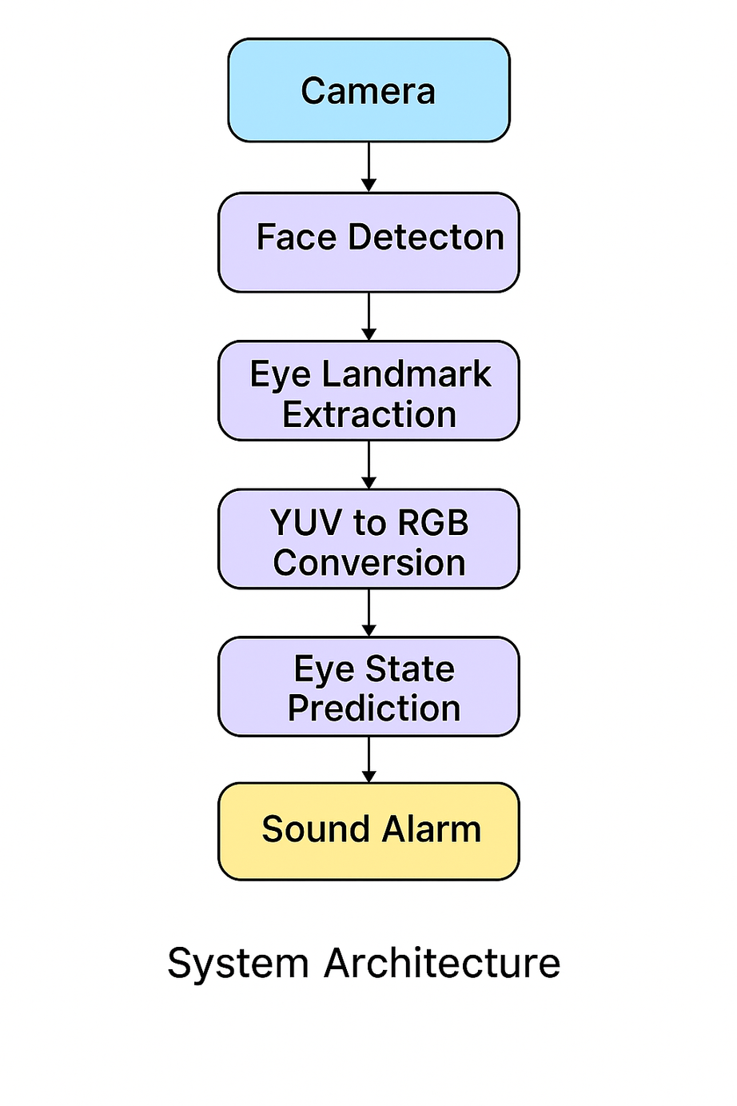
System Architecture

Slide 34
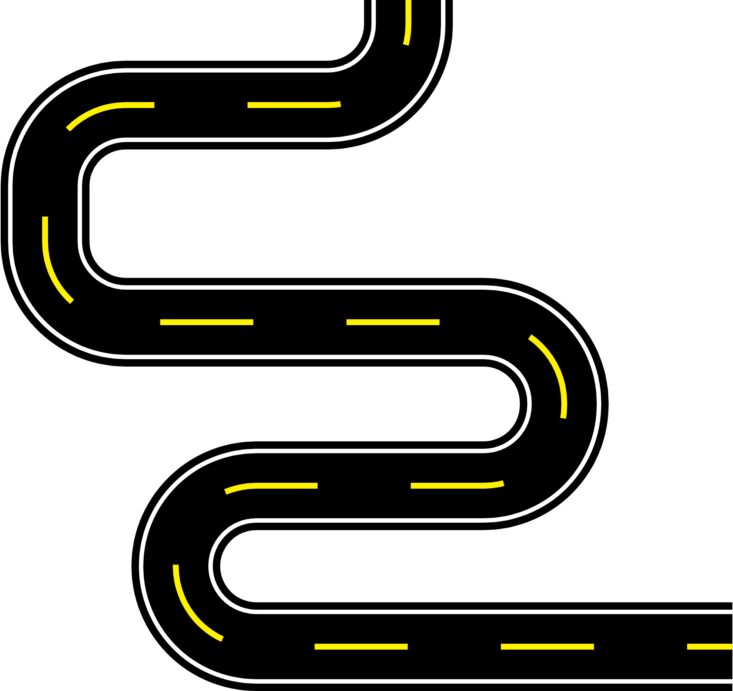





Slide 35
Mobile App Deployment
Real-Time Camera Streaming:
Uses the front camera via CameraController for live video feed.
Captured frames are in YUV420 format (default on Android devices).

Slide 36
Mobile App Deployment
Face & Eye Landmark Detection:
Google ML Kit processes raw YUV frames directly, handling internal conversion and rotation.
Detects the face and extracts landmarks (e.g., left and right eye positions).

Slide 37
Mobile App Deployment
Eye Region Processing:
Extracts left and right eye coordinates from ML Kit landmarks.
Computes the angle between eyes to horizontally align cropped regions.
Applies manual YUV to RGB conversion for inference input.
Crops and resizes each eye region to 64×64, normalized to [0,1].

Slide 38
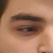
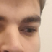
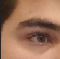
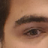
Mobile App Deployment
Samples of successful processing and predicting of head tilting and different angles due to:
Eye region processing technique
Training the model under variant conditions using data augmentation

Slide 39
Mobile App Deployment
TFLite Model Inference:
Custom eye-state model trained using TensorFlow.
Converted to TensorFlow Lite format with quantization for:
Reduced size
Faster inference
Lower memory usage
Model input shape: [1, 64, 64, 3], float32 RGB
Model outputs eye state probabilities: [closed, open]

Slide 40
Mobile App Deployment
Drowsiness Logic & Alarm:
Recent eye closure history is stored.
If 2 or more of the last 3 frames indicate closed eyes → increase score. Otherwise, it decreases the score.
Alarm sounds only when score passes the threshold.
Alarm stops only when score decreases below the threshold

Slide 41
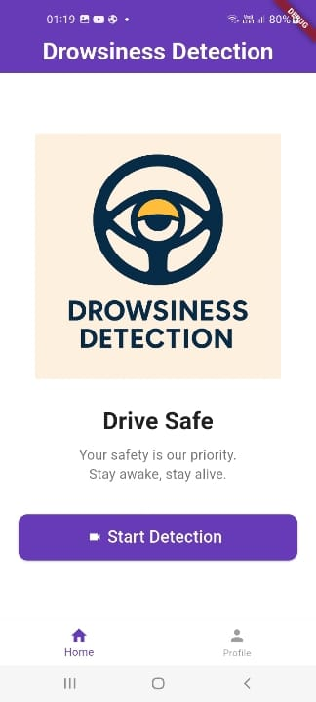
Home Page UI

Slide 42
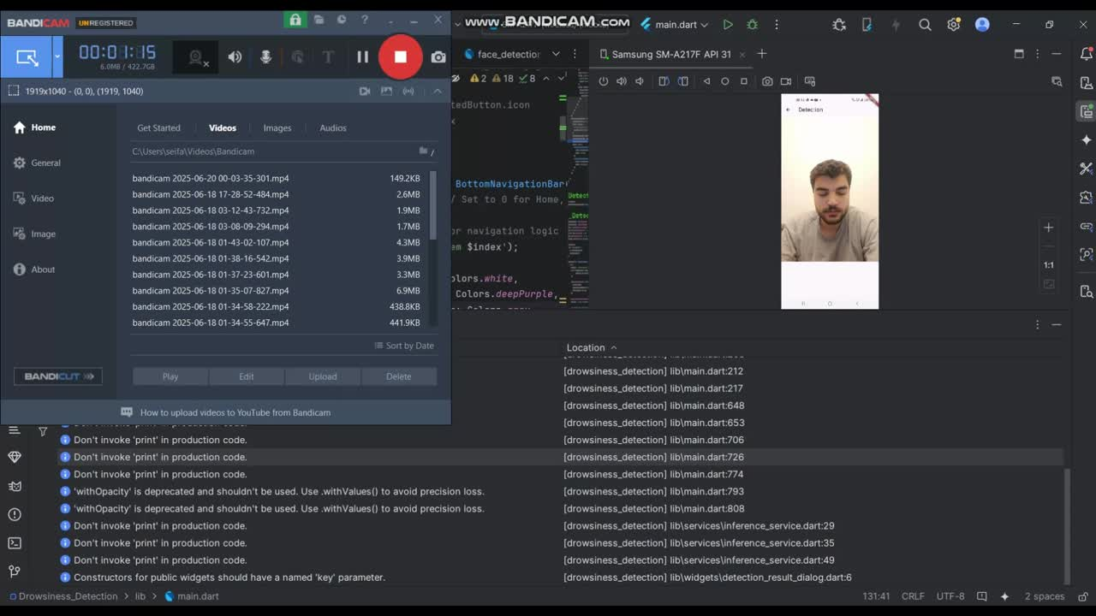
Mobile App Deployment
Under Normal Conditions:
In a 47 frames test, 40 frames were correctly processed and predicted with accuracy of 85%

Slide 43

06 Results & Analysis

Slide 44
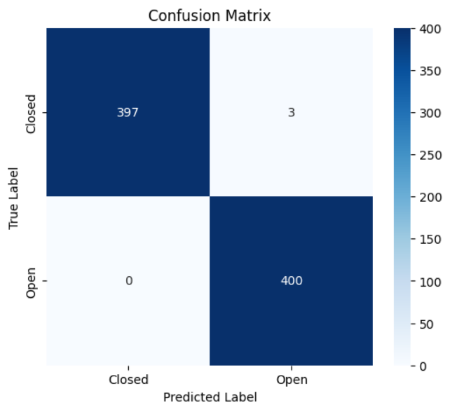

Slide 45
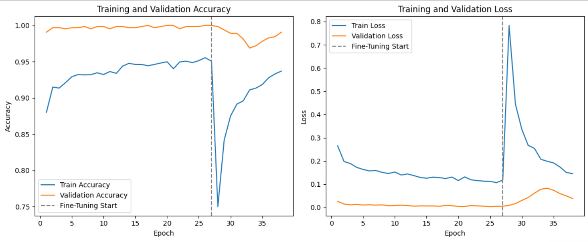

Slide 46
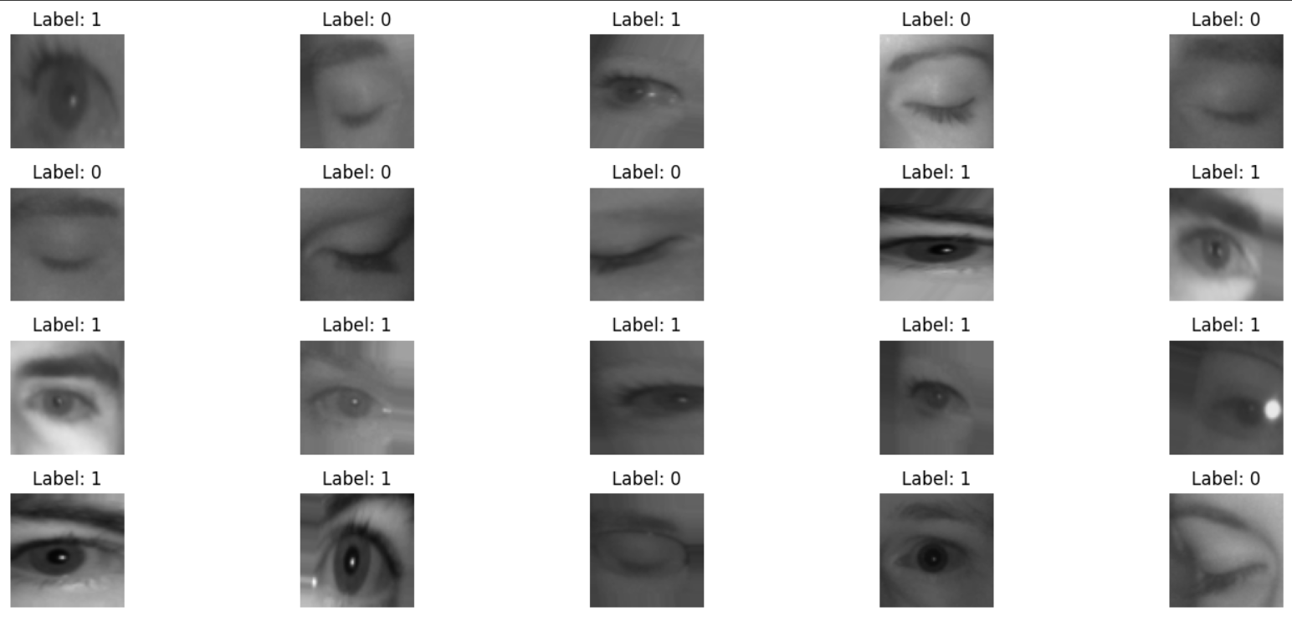

Slide 47


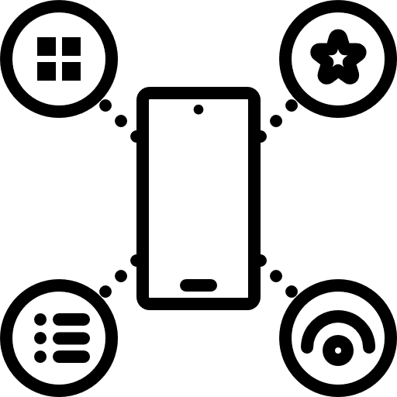
Future Work
Vehicle Acceleration
Face Expressions Detection
IOS App Deployment
Extra Application Features

Slide 48


